Slide 1

Telecom Industry
User Data Analytics
By:- Deewankar Sharma

Slide 2




PROBLEM & DATA
OVERVIEW
Our Mission
Business objective
Analysis objective
User overview analysis
OUR PROCESS
User engagement analysis
User experience analysis
User satisfactory analysis
TARGET
Results
Recommendation
Conclusion

Slide 3



Introduction
Objective:
Analyze telecom user data to uncover patterns in user engagement, data usage, and handset preferences.
Clean, preprocess, and explore the data to extract meaningful insights.
Data Source:
A dataset consisting of telecom user data including handsets, data usage metrics, and session details.

Slide 4

Data Cleaning and Preprocessing
Initial Data Inspection:
Number of rows and columns: db.shape
Missing values: Display of percentage and columns with missing data.
Actions Taken:
Removed rows with more than 20% missing values.
Filled missing values for numerical columns with the median.
Filled missing values for categorical columns with the most frequent value.
Dropped duplicate rows.

Slide 5
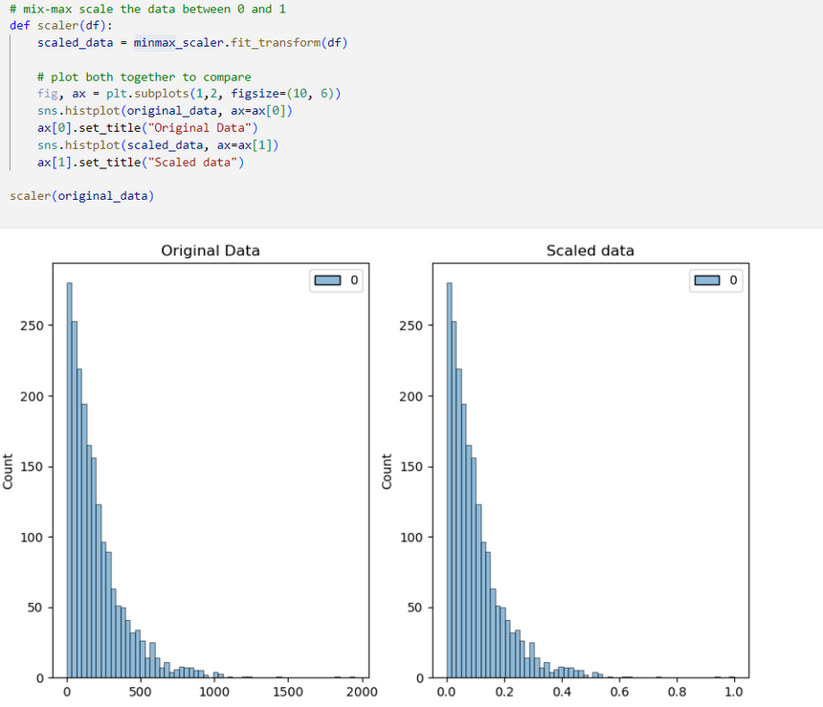


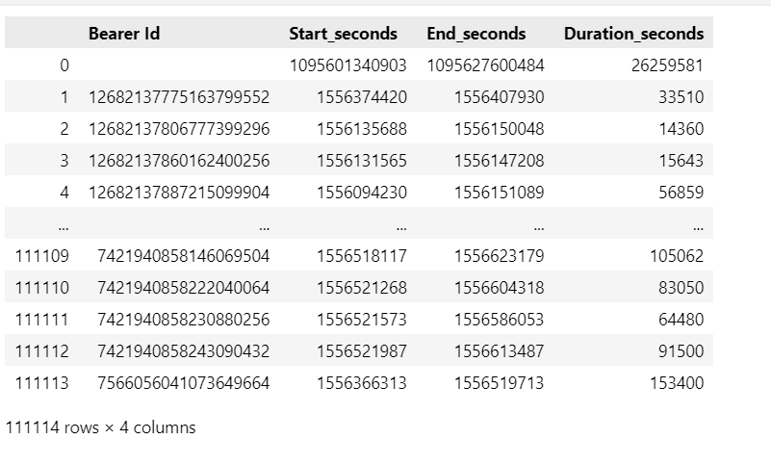
Data Preprocessing
Scaling:
Applied MinMaxScaler to scale numeric columns.
Datetime Conversion:
Converted Start and End columns to datetime and calculated session duration in seconds.

Slide 6
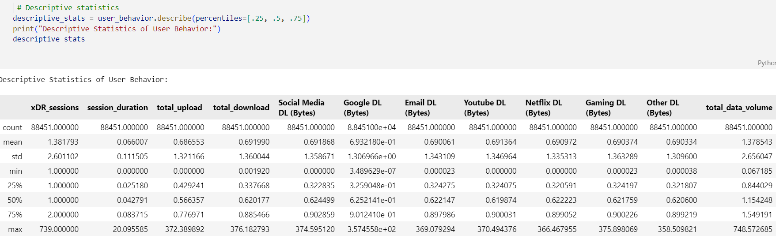
Descriptive Statistics
Overview:
Summary of key statistics: mean, median, standard deviation, etc.
Sample statistics: Example of descriptive statistics for data columns such as download/upload bytes.

Slide 7
Key Insights
Sessions:
Average sessions per user: 1.38, but some users have up to 739 sessions.
Average session duration: 4 minutes (0.066 hours), with a few lasting over 20 hours.
Data Usage:
Average upload/download per session: 0.69 units, with maximums exceeding 370 units.
Significant variance in data usage, indicating a small number of heavy users.
Platform-Specific Data:
Social Media, YouTube, Netflix: All have similar average downloads (~0.69 units), with maximums of 366-374 units.
Gaming: Similar average, with a maximum download of 375 units.
Outliers:
Extreme outliers in session duration (20+ hours) and data usage (up to 748 units).
Total Data Volume:
Average total data per user: 1.38 units, with the top users consuming up to 748 units.
General Behavior:
Most users have moderate usage, while a small percentage exhibit extremely high data consumption (social media, streaming, and gaming).

Slide 8

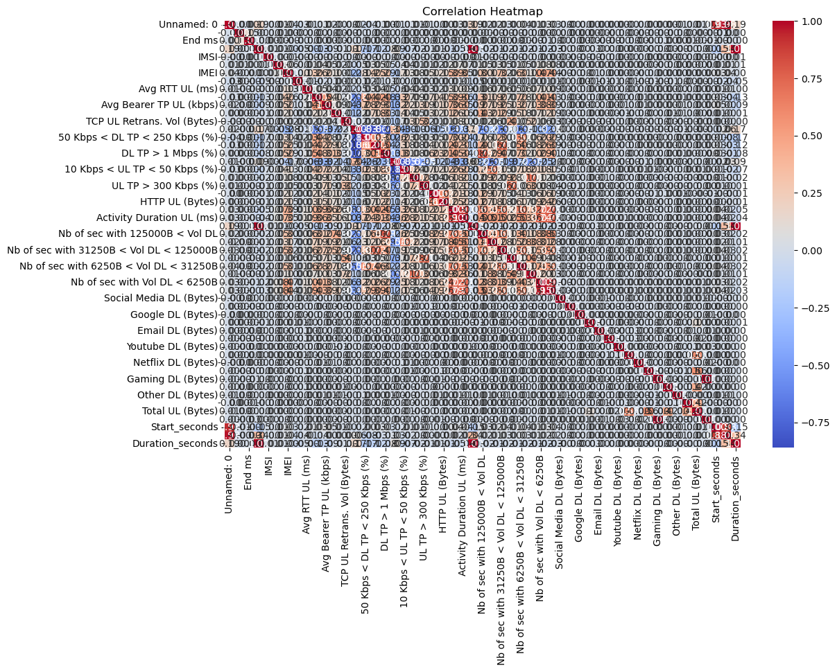
Correlation Analysis
Objective:
Understand relationships between variables (e.g., data usage, session duration).
Heatmap:
Display a heatmap of the correlation matrix to show relationships between features like Google DL/UL, YouTube DL/UL, etc.

Slide 9

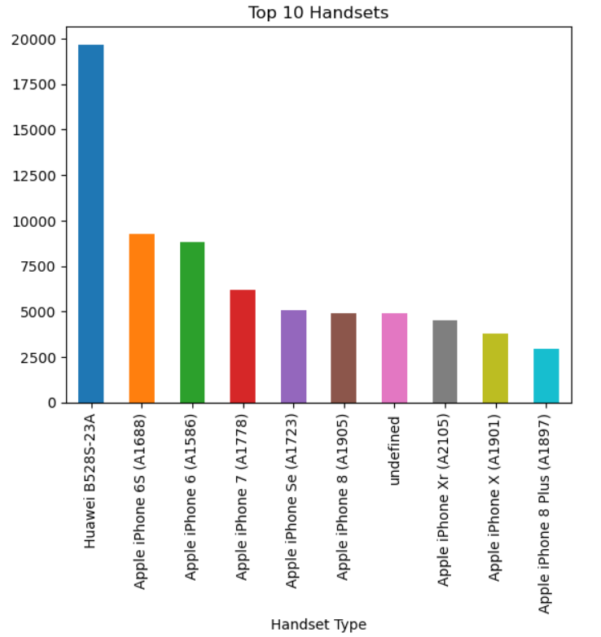
Handset Insights
Top 10 Handsets
•The analysis reveals a variety of popular handset models among customers, comprising the top 10 preferences.
•The Huawei B528S-23A emerges as the most widely used handset, with a substantial count of 19,752 occurrences.
•Apple iPhone models, including the iPhone 6S, iPhone 6, iPhone 7, iPhone SE, iPhone 8, iPhone XR, and iPhone X, also feature prominently in customer device choices.
•The presence of 'undefined' in the dataset suggests a category where handset types may not be explicitly identified, indicating potential areas for data refinement.
•This analysis provides valuable insights into the popularity of specific handset models, enabling businesses to tailor services and optimize user experiences effectively.

Slide 10

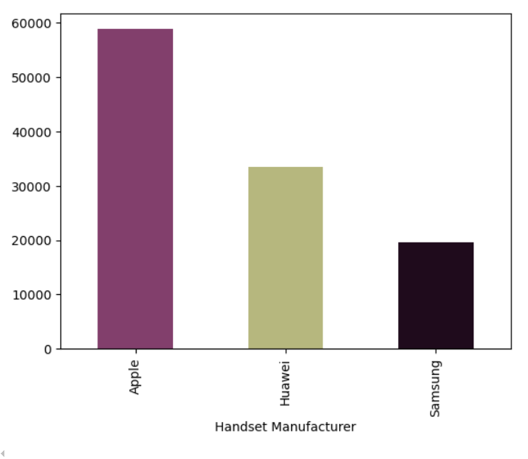
Top 3 handset manufacturers
•Apple, Samsung, and Huawei emerge as the top three handset manufacturers in the dataset.
•Apple exhibits the highest representation with 59,464 occurrences, followed by Samsung with 40,579 occurrences, and Huawei with 34,366 occurrences.
•This data underscores the dominance of these manufacturers in the market, shaping consumer preferences and influencing industry trends.
•Understanding the market share and presence of these key players is vital for strategic decision-making and market positioning within the telecommunications industry.

Slide 11

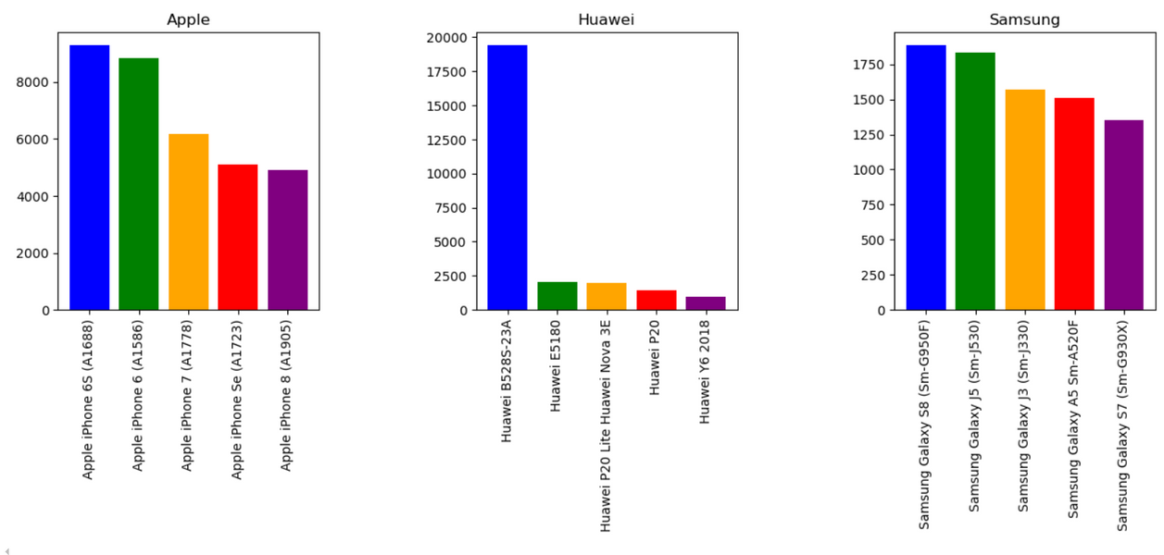
Top 5 handsets per top 3 manufacturers
Apple Handsets:
•Most Popular: iPhone 6S
•Followed by: iPhone 6, iPhone 7, iPhone SE, iPhone 8
Huawei Handsets:
•Top Model: B528S-23A
•Others Include: E5180, P20 Lite/Nova 3E, P20, Y6 2018
Samsung Handsets:
•Leading Model: Galaxy S8
•Other Popular Models: Galaxy A5, Galaxy J5, Galaxy J3, Galaxy S7

Slide 12
Recommendations for Marketing team
PROMOTION STRATEGY
Leverage the popularity of the Huawei B528S-23A model through promotions or special offers to attract more customers.
APPLE FOCUS
Focus marketing efforts on Apple iPhones, highlighting their unique features and benefits to maintain and grow market share, given their significant presence.
DRIVING URGENCY
To foster a feeling of urgency, come up with exclusive bundles or time-limited offers showcasing these top phones. Work together on co-branded campaigns with these manufacturers, maybe including customer input into future product development.

Slide 13
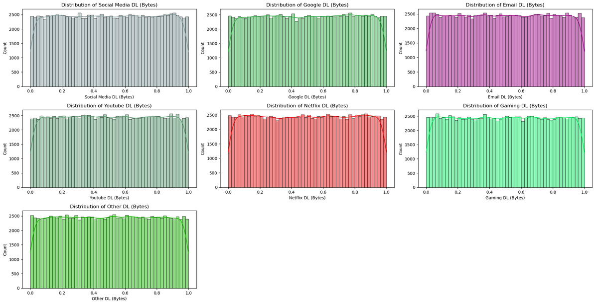
GRAPHICAL UNIVARIATE ANALYSIS
Uniform Distribution: Download volumes across categories (Social Media, Google, Email, YouTube, Netflix, Gaming, Other) are consistently distributed.
Minimal Skewness: No category shows a dominant download size range; distribution is evenly spread.
Small Variation in Sizes: No extreme peaks or dips in download sizes; behavior is consistent without unusual extremes.
Even Distribution for Major Services: Major services (YouTube, Netflix, Gaming) also show even distribution of download sizes, indicating balanced user engagement.

Slide 14


PairPlots Analysis

Slide 15
Building & improving the QoS (Quality of Service) to leverage the mobile
platforms and to get more users for the business is good but the success of the
business would be determined by the user engagement and activity of the
customers on available apps
USER ENGAGEMENT ANALYSIS
Most of the users had very few sessions but used
much data bytes in the few sessions they had.

Slide 16
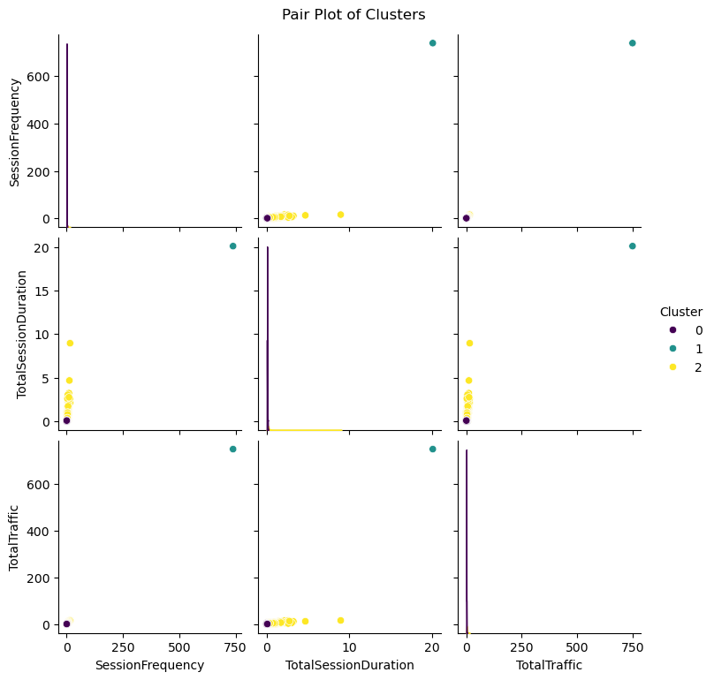
KMeans clustering is used to segment users into 3 clusters based on engagement metrics.

Slide 17
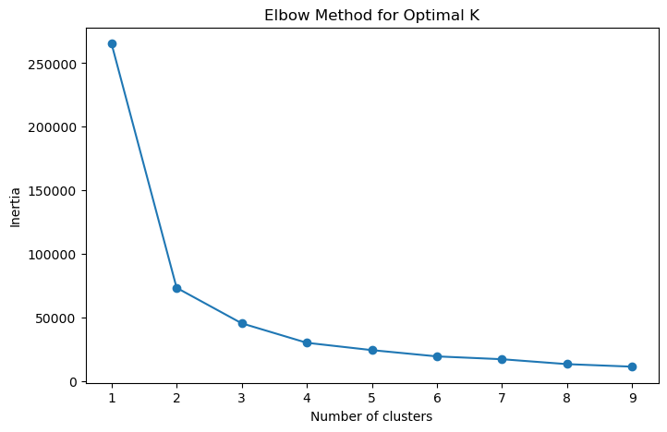
OPTIMIZED K-VALUE OF ENGAGEMENT
CLUSTERS
Using Elbow Method
The elbow method suggests that the optimal number of clusters is 2. This is because the graph has a sharp decrease in inertia from 1 to 2 clusters, after which the decrease in inertia becomes less steep. This indicates that there is a significant gain in clustering performance from 1 to 2 clusters, but the gains become less significant after that.

Slide 18
USER EXPERIENCE ANALYSIS
It is so important to track and evaluate the customer’s experience to optimize their products and
services so that it meets the evolving user expectations, needs and acceptance.

Slide 19
User Experience Cluster
COUNT DESCRIPTION
This cluster contains the vast majority of customers. The large number indicates that Cluster 0 represents a significant portion of your customer base, and this cluster has high throughput, low retransmission, and low RTT. Customers in this cluster are experiencing the best network performance.
CLUSTER 0
88214
CLUSTER 1
This is an extremely small cluster with only one customer. This indicates that this cluster's performance metrics are intermediate, with moderate throughput, retransmission, and RTT.
1
CLUSTER 2
This cluster has a relatively small number of customers compared to Cluster 0. It represents customers with low throughput, high retransmission, and high RTT. These customers are facing significant network issues and likely have a poor experience.
236

Slide 20
USER SATISFACTION ANALYSIS
The Satisfaction of the customers heavily depends on the experience of the user.

Slide 21
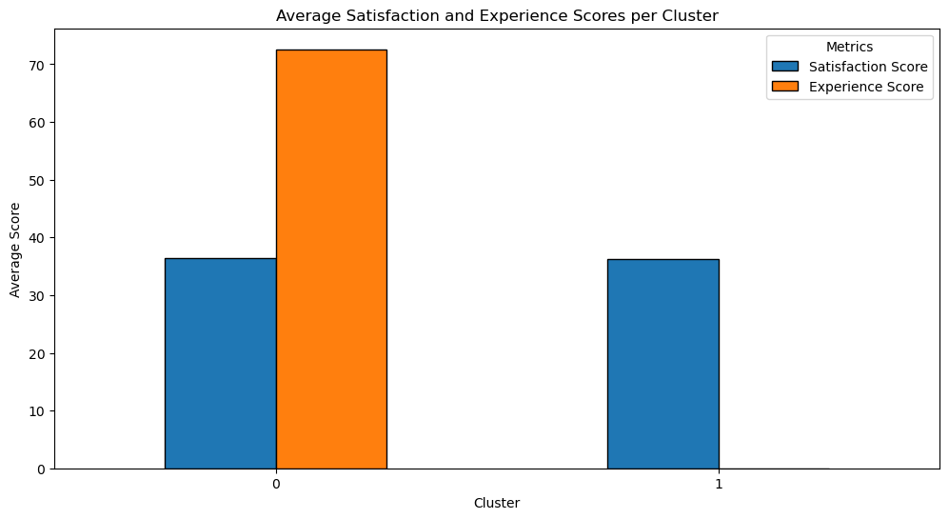

Slide 22
Key Insights
Customer Segmentation:
High Engagement: Large cluster with high engagement scores.
Low Engagement & Poor Experience: Smaller clusters needing significant improvement.
Top Satisfied Customers:
Identified top 10 customers with the highest satisfaction scores.
Regression Analysis:
Metrics like TCP retransmissions, RTT, and throughput significantly impact satisfaction scores.
Cluster Analysis:
Visualized differences in engagement and experience scores across clusters.
Highlighted which clusters perform best and worst.
Recommendations:
Improve Engagement: Focus on enhancing engagement for low-scoring clusters.
Address Poor Experience: Fix issues related to RTT and throughput in struggling clusters.

Slide 23
Recomendations
Boost Engagement: Implement personalized offers and improved interactions for low-scoring clusters.
Improve Experience: Enhance network performance, reduce RTT, and address high retransmission rates.
Leverage Top Performers: Replicate successful strategies of highly satisfied customers.
Monitor Metrics: Regularly track key metrics and adjust strategies based on trends.
Explore Further: Analyze demographics and usage patterns to tailor services more precisely.

Slide 24

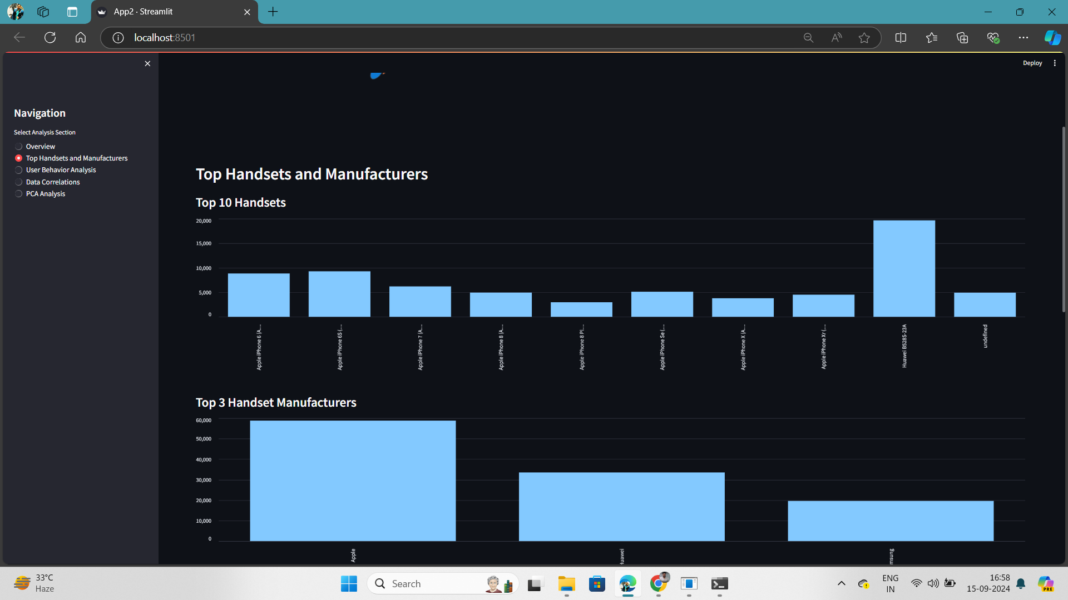
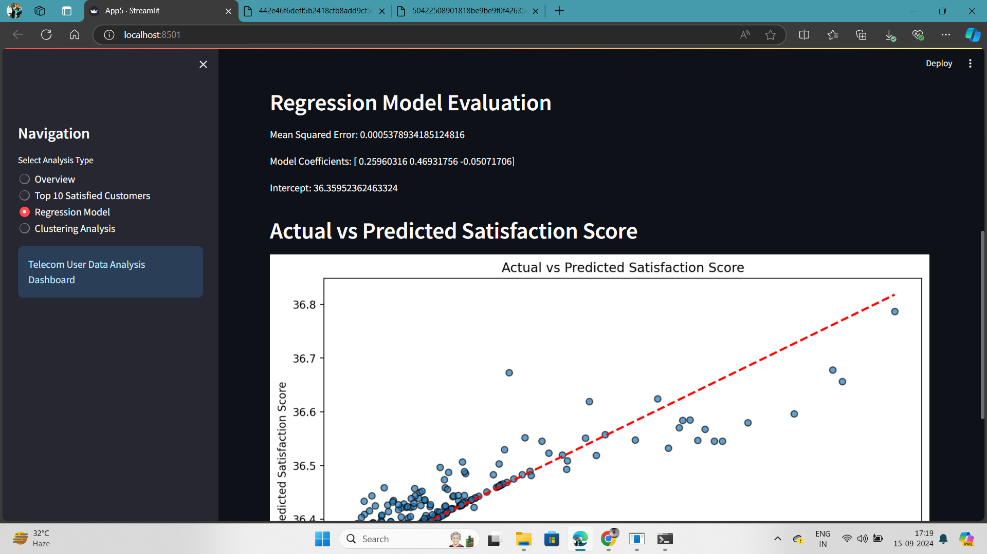
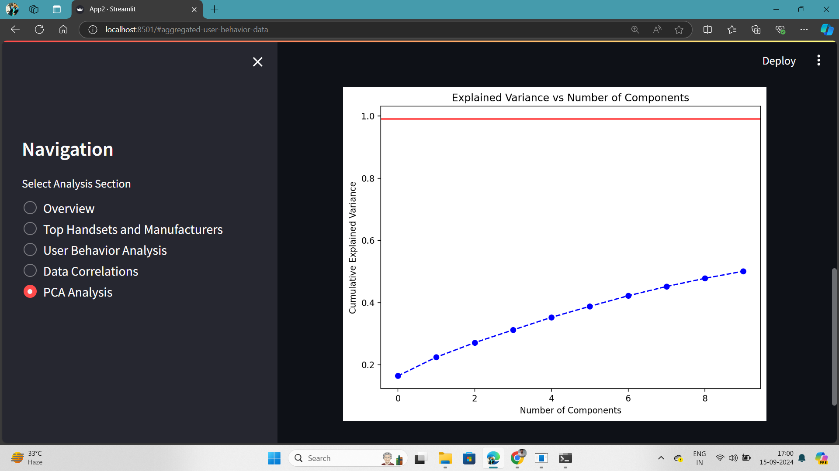
Dashboard

Slide 25


